Slide 1

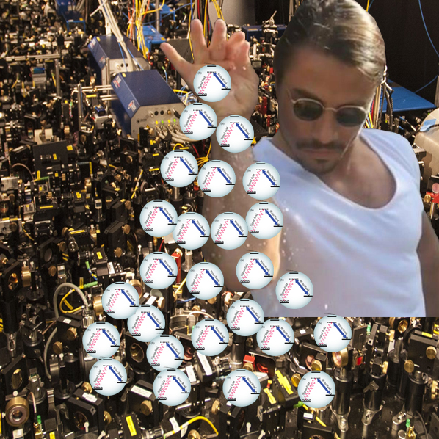
The magic of
Dark-State Polaritons
Mehdi Namazi
(Not the guy on the right)
Quantum Information Technology
Laboratory

Slide 2
EIT

Slide 3
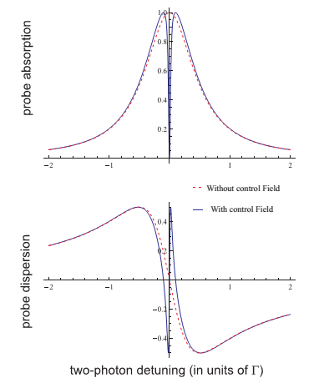
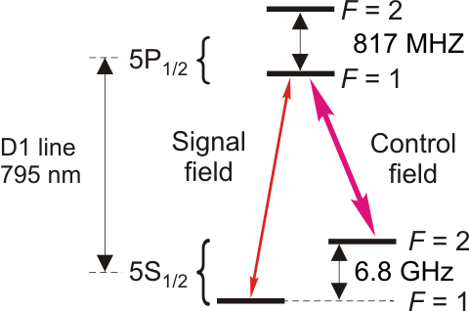
Electromagnetically Induced Transparency (EIT)
D1 Line @ 795nm
Rev. Mod. Phys. 77, 633 (2005)

Slide 4



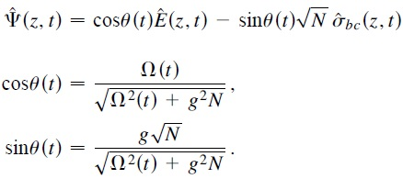

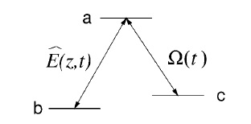
EIT : A deeper look
With a quantized field:
And the collective atomic operators:
One can solve a set of Heisenberg-Lagevin equations:
A simple solution to these equations is:
This is the Dark-State Polaritons wave function!
PRL 84, 5094 (2000)

Slide 5



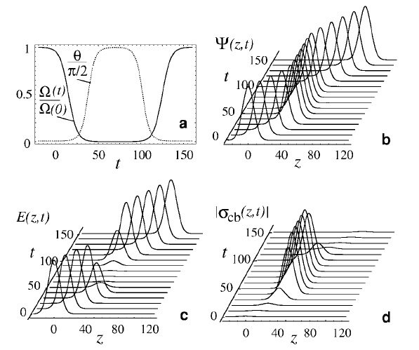
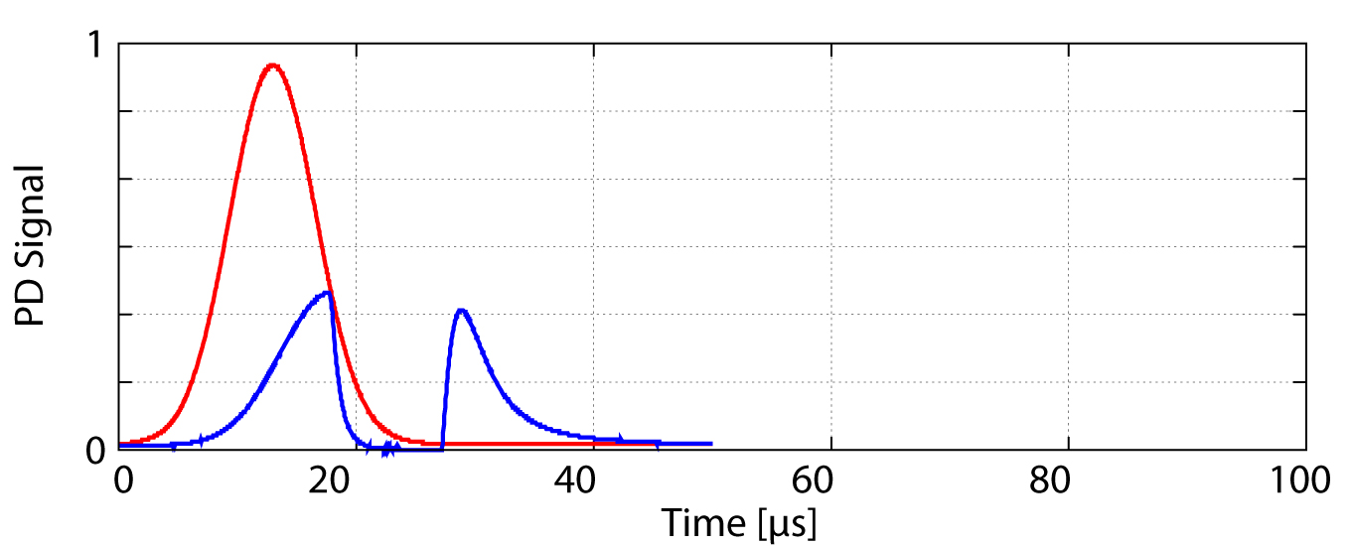
Using EIT for light storage
P
Ctrl

Slide 6
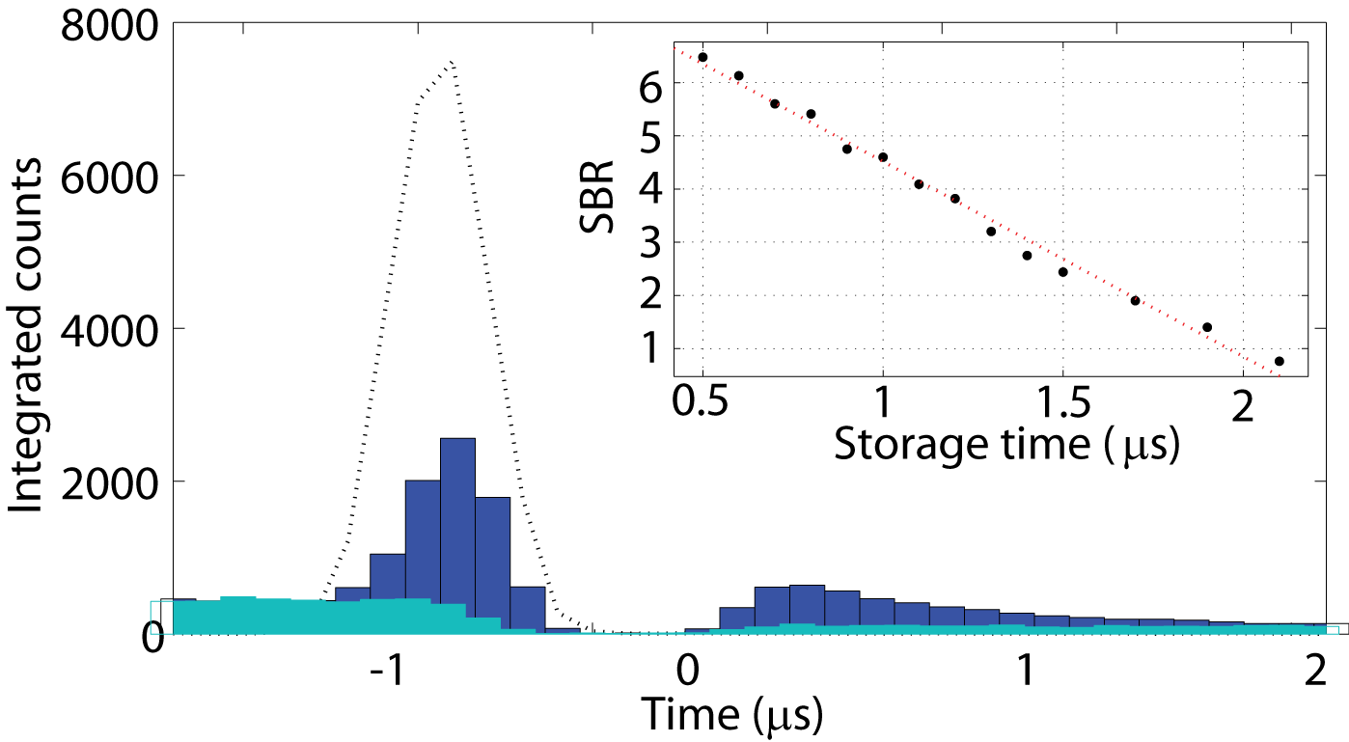
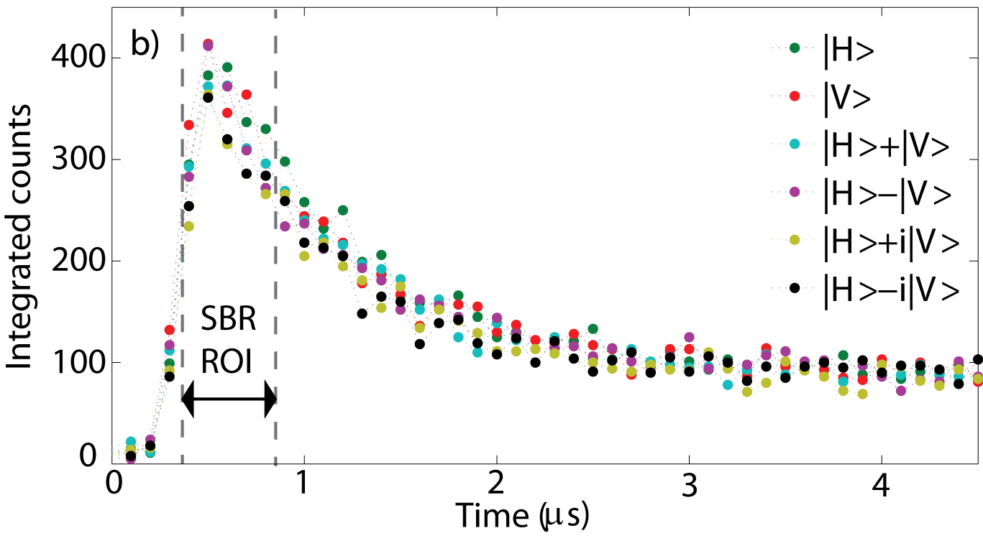
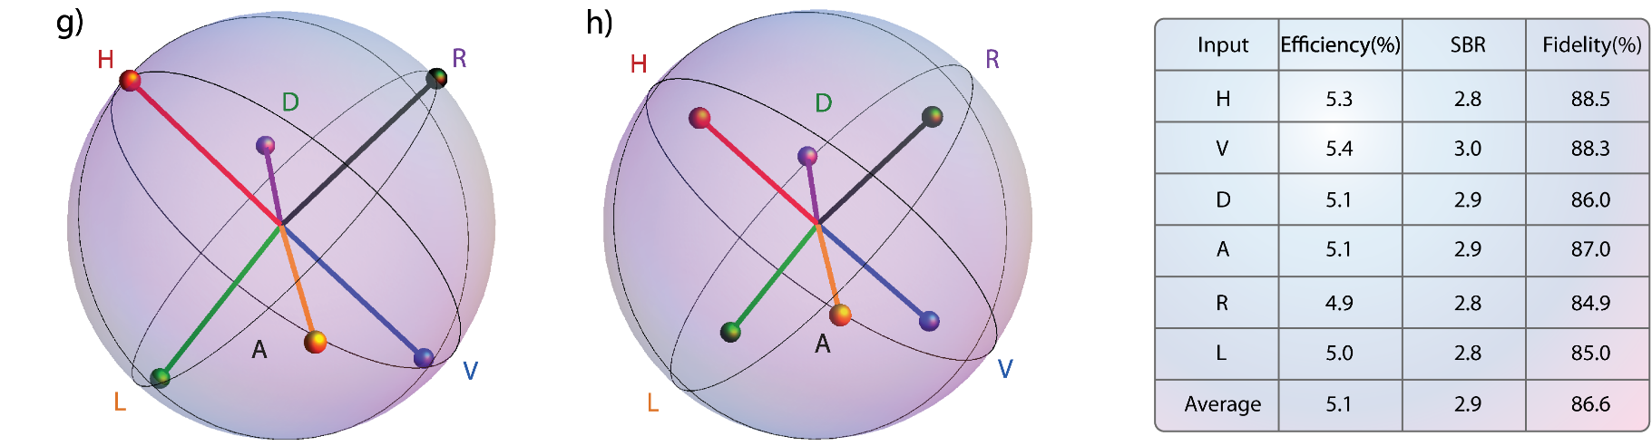
Improvement of signal to background ratio
arXiv:1512.07374 (2015).

Slide 7
Applications of DSP

Slide 8
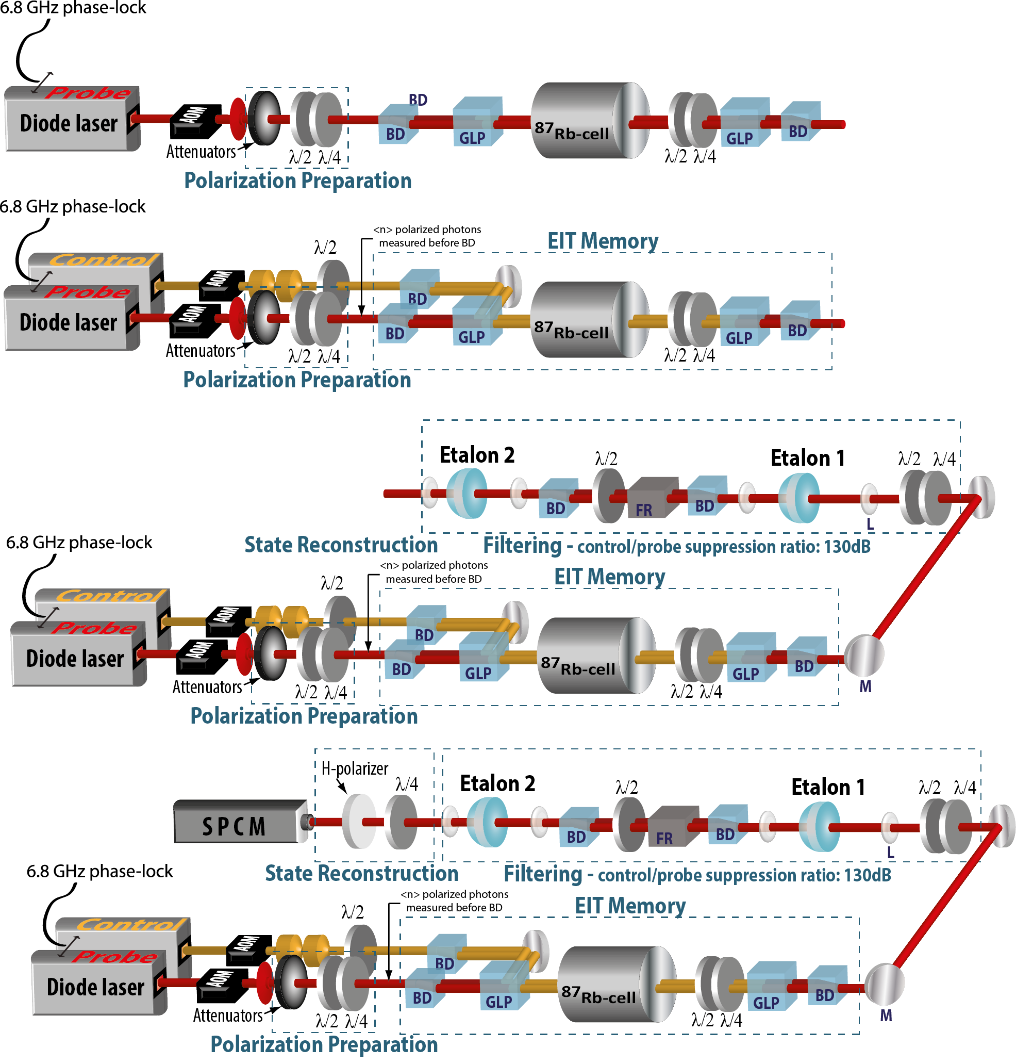
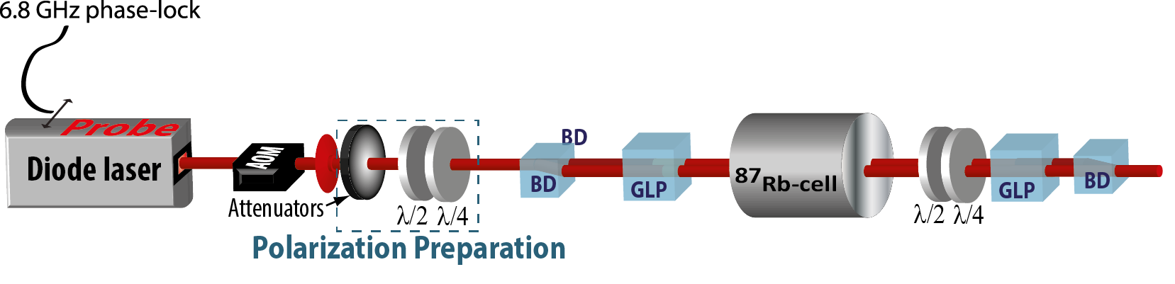
Storing photonic qubits in warm vapor
Scientific Reports 5, 7658 (2015).

Slide 9
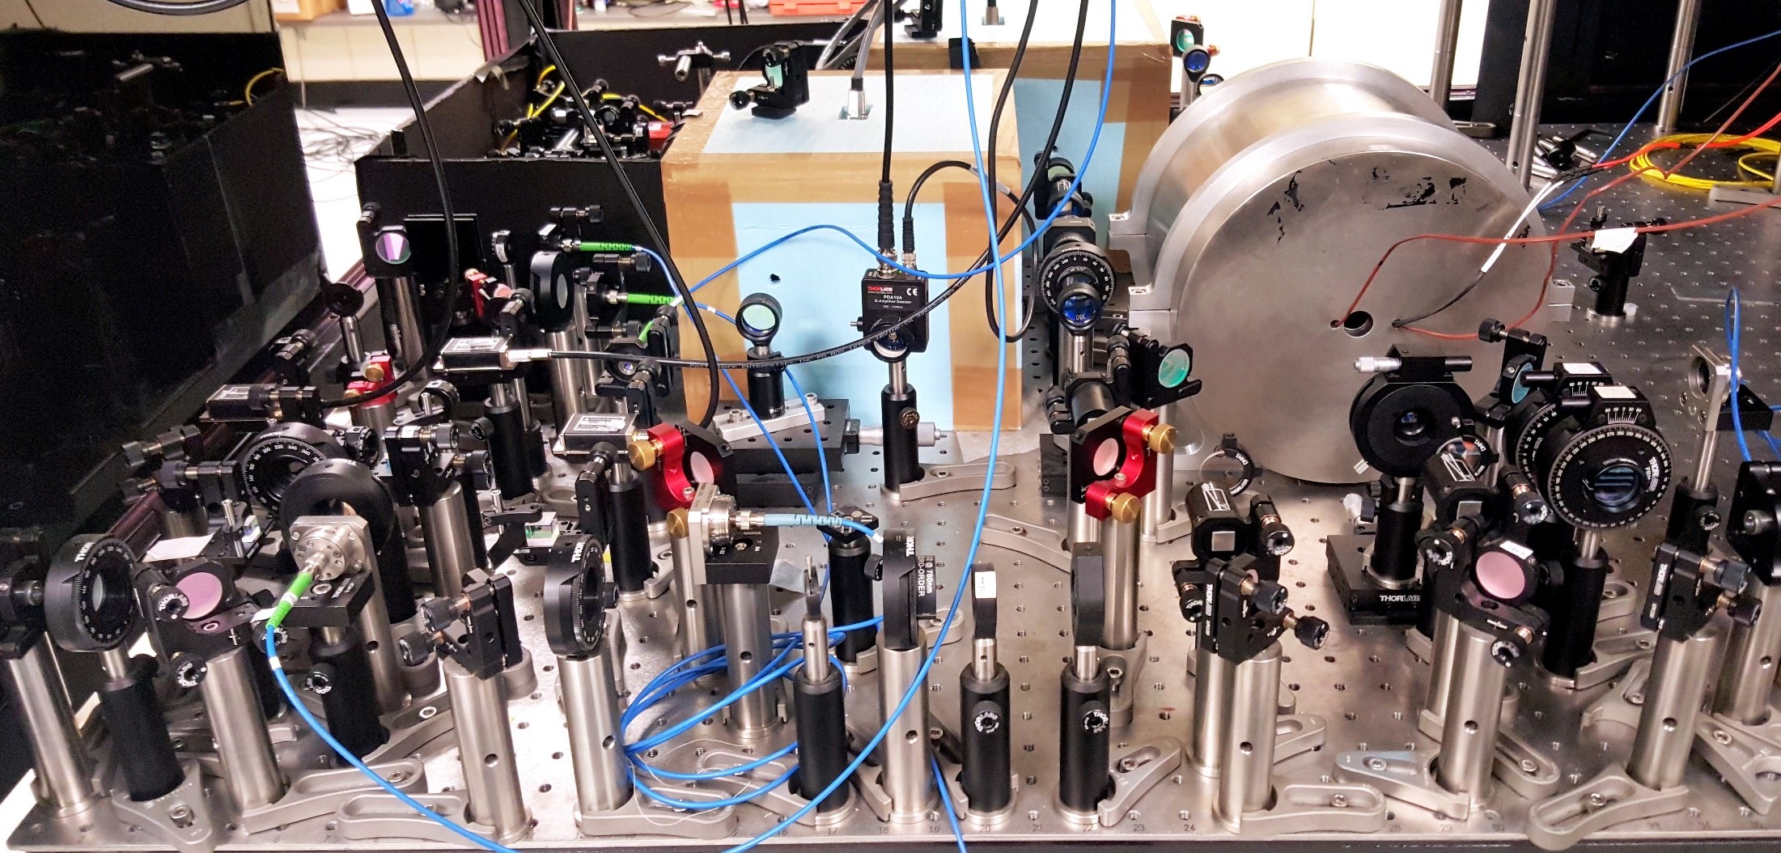
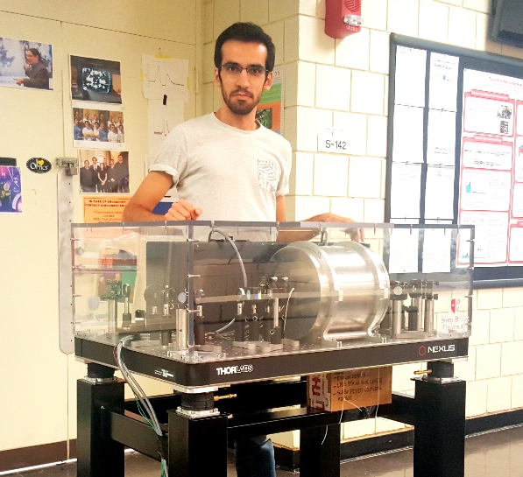
Quantum memory setup
Quantum State Characterization
Filtering system
Quantum Memory
Photon Generation
Probe

Slide 10
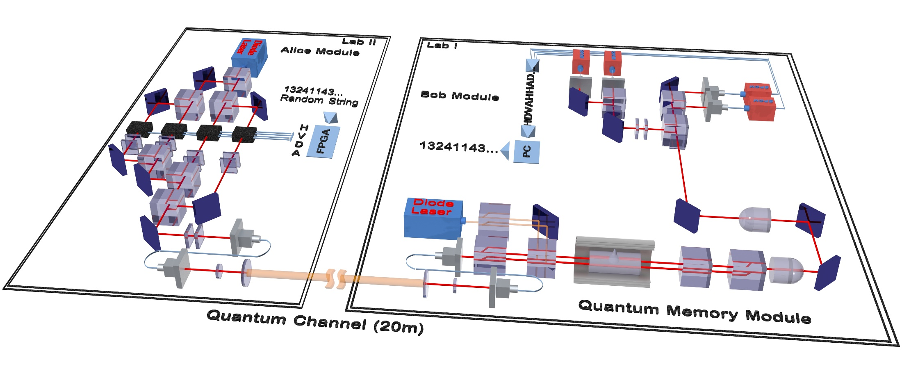
Towards Ultra-secure communication networks
arXiv:1609.08676 (2016)

Slide 11
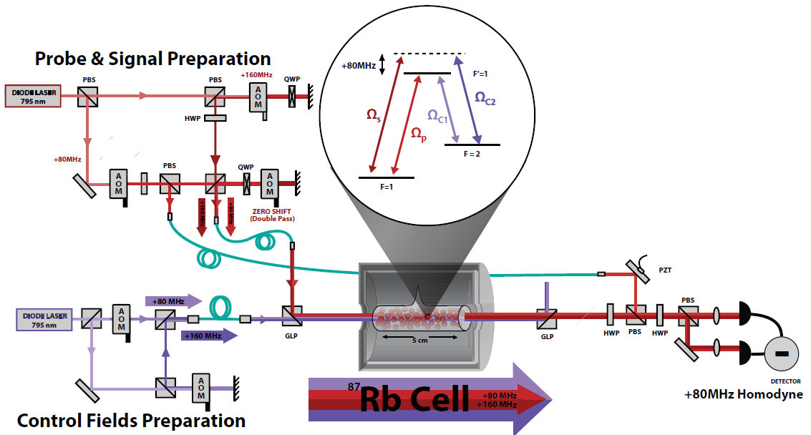
Towards photon-photon interactions

Slide 12
Background information I: A quantum simulator using dark state polaritons (DSP)
EIT setup
Multiple EIT systems
- Key idea: build several interacting EIT systems.
Spinor of light setup
Original proposal: PRL 105, 173603 (2010).

Slide 13
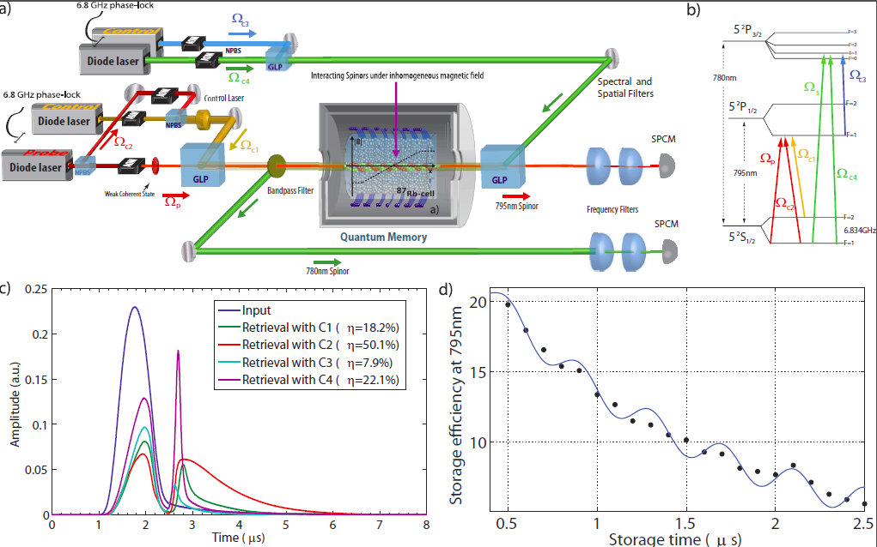
Quantum Simulation with atoms and photons

Slide 14
Background information II: Dirac dynamics using spinor of light
Having two Dark State Polaritons of the form:
Can be explained in terms of the spinor of light:
The spinor obeys a Dirac-like equation:
PRL 105, 173603 (2010).

Slide 15
Background Information III. Jackiw-Rebbi model
Describes a Dirac field coupled to a soliton or a spatially dependent mass term.
Predicts charge fractionalization and is a precursor to topological insulators.
A double-tripod EIT scheme follows Dirac dynamics.
Original proposal: Scientific Reports 4, 6110 (2014).

Slide 16
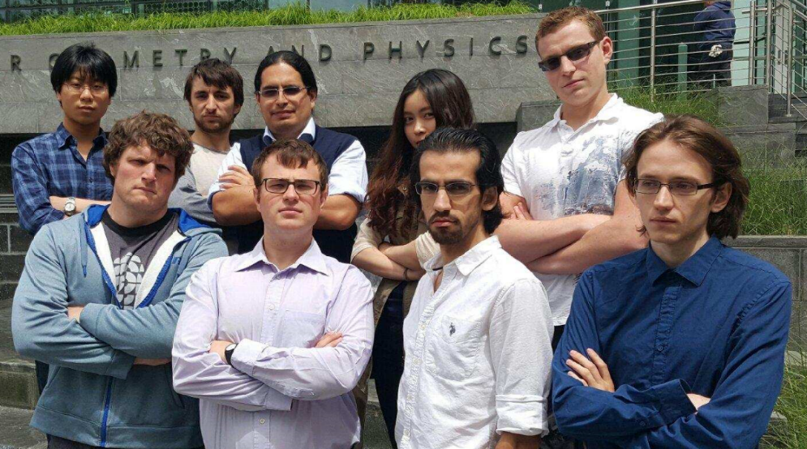
Thank You for your time ☺

Slide 17
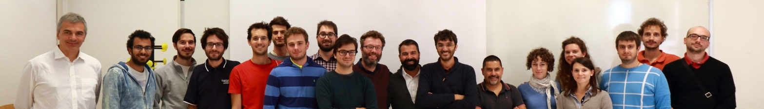
Thank You ☺
Special thanks to:
Paolo Villoresi (QF lab)
Giuseppe Vallone (QF lab)
Eden Figueroa (QIT lab)
Reihaneh Shahrokhshahi (QIT)
Bertus Jordaan (QIT)
Connor Goham (QIT)
And many more ...

